Slide 1
ACID
pH: 1-6
Gives H+ to a solution
→strong acids can burn
Ex: lemon juice, stomach acid
BASE
pH: 8-14
Removes H+ from a solution making -OH
→Soapy, used for cleaning
Ex: NaOH, ammonia
0
7
14
Neutral H2O
More Acidic
More Basic

Slide 2
Buffers
pH of the blood should be maintained at 7.4. If the pH drops below 6.8 or rises above 7.8, death may occur. Fortunately, we have buffers in the blood to protect against large changes in pH.
The most important way that the pH of the blood is kept relatively constant is by buffers dissolved in the blood.
Which helps maintain HOMEOSTASIS!!!
Depression
Hyper

Slide 3
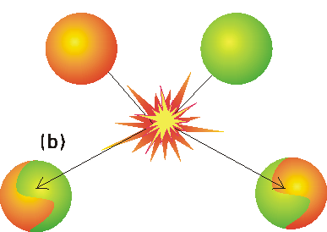
Chemical Reactions
Chemical Reactions- when bonds between atoms are formed or broken
CH₄ +2O₂ -------> CO₂ + 2H₂O
Reactants Products
Metabolism - all the chemical reactions that occur inside an organism
Some reactions require energy to occur, this is why we consume food
Others release energy, which may be used by the cell to do other work

Slide 4
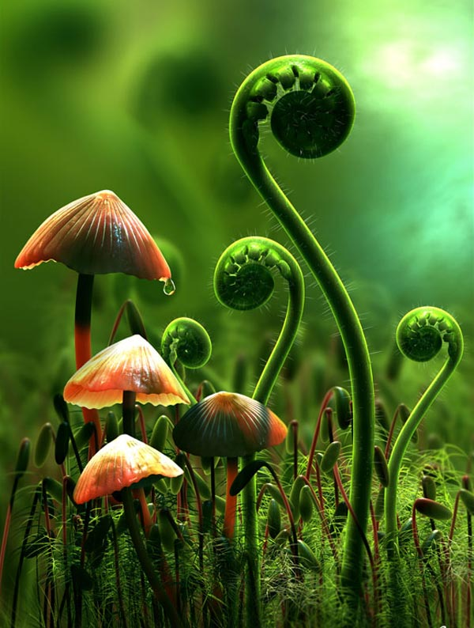
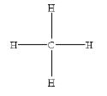
Organic Molecules
Organic means it contains carbon, all Living things have carbon.
Carbon can make up to 4 bonds with other elements
Carbon Bond Examples:
* Four Single Bonds - CH₄ * Two Double Bonds - CO₂
* One Triple Bond - C₂H₂

Slide 5
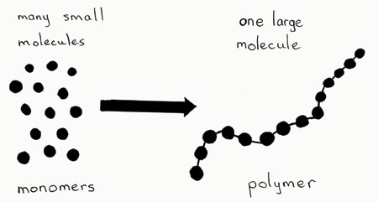
Organic Molecules
Monomer
an organic molecule made up of one unit
Ex. Train car [o]
Polymer
an organic molecule made up of long chain of repeating units
Ex. train [o]---[o]---[o]---[o]

Slide 6
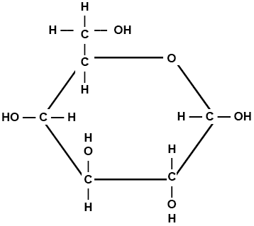
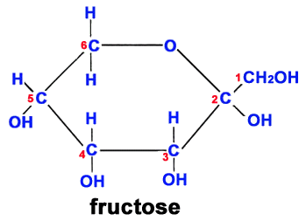
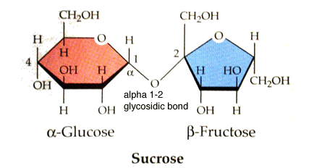
Carbohydrates - [S]-[U]-[G]-[A]-[R]-[S]
Carbohydrates are used to store and release energy. QUICK ENERGY
They are compounds made of C, H, and O atoms.
1. Monosaccharide – Monomer , ring carbohydrate
Ex. Glucose and fructose
2. Disaccharide – two sugar carbohydrate
Ex. Table Sugar - glucose bonded to fructose

Slide 7
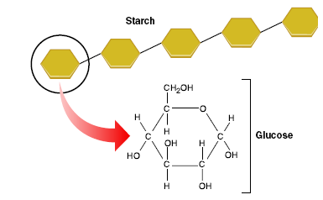
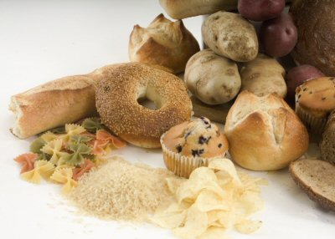
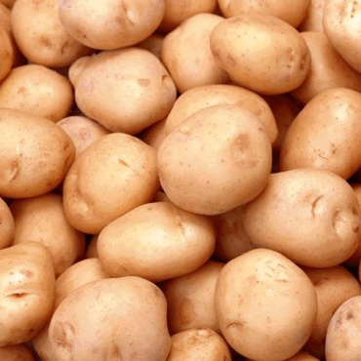
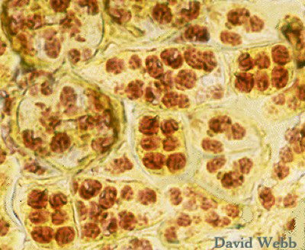
Carbohydrates (cont.)
3. Polysaccharide - polymer carbohydrate. The repeating monomer for all 3 types (A-C) is glucose.
Example:
Starch - a spiral chain of glucose.
Made by plants as a storage molecule.
Starch granules in plant cells

Slide 8
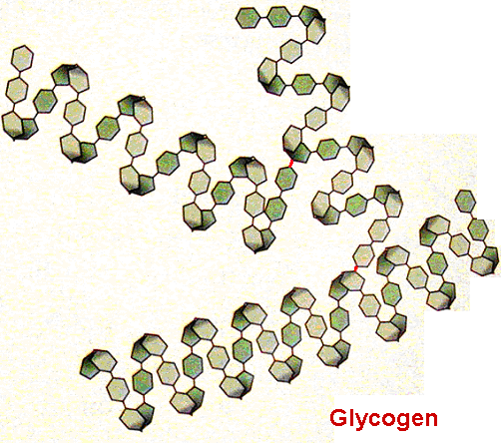
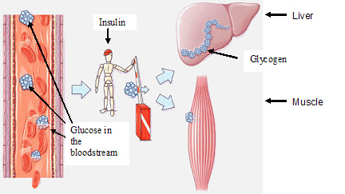
Carbohydrates (cont.)
3. Polysaccharide - polymer carbohydrate. The repeating monomer for all 3 types (A-C) is glucose.
B. Glycogen - a chain of glucose made
by animals to store excess glucose after a meal.

Slide 9
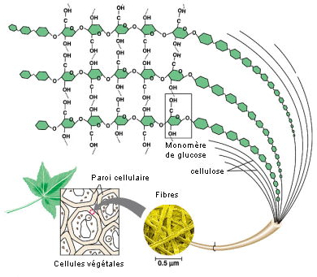
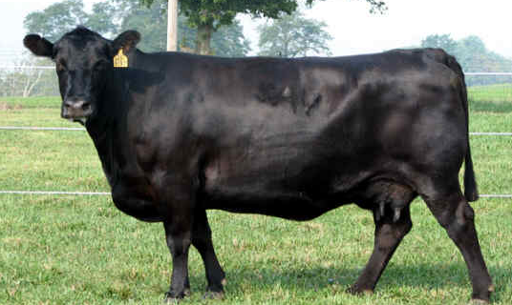
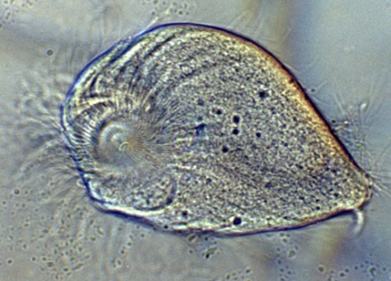
Carbohydrates (cont.)
3. Polysaccharide - polymer carbohydrate. The repeating monomer for all 3 types (A-C) is glucose.
Cellulose - chain of glucose hooked together like a chained link fence.
Made by plants for cell wall support.
Humans cannot digest cellulose.

Slide 10
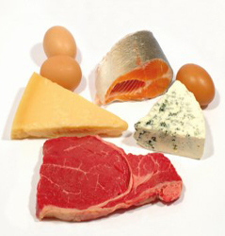
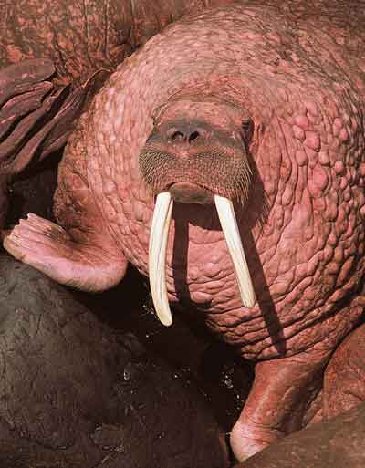
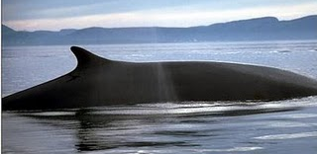
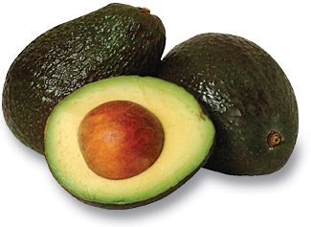
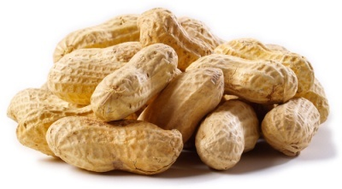
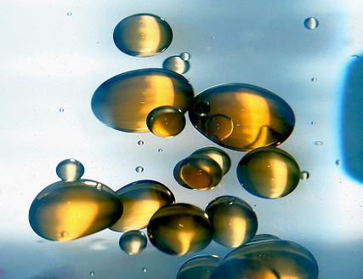
Lipids
Compounds made of C, H, and O
Used for long term energy storage, insulation and protective coatings
Foods with the high amount of lipids have the greatest potential energy available. Ex. Peanuts and Avocados
Lipids are non-polar & do not dissolve in water (water is polar, likes dissolve likes)

Slide 11
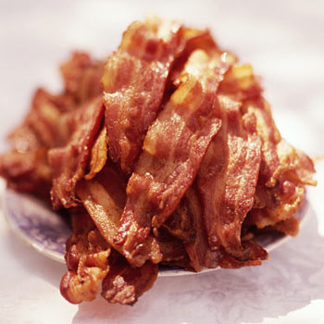
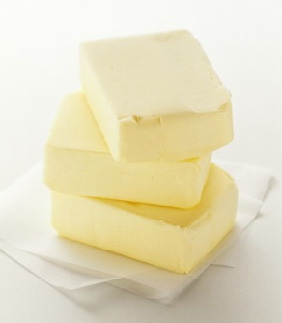
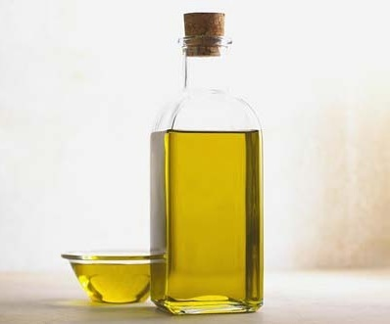
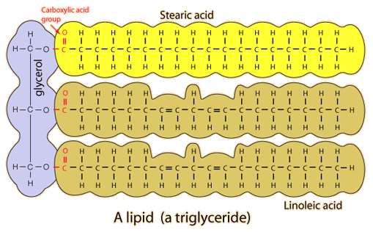
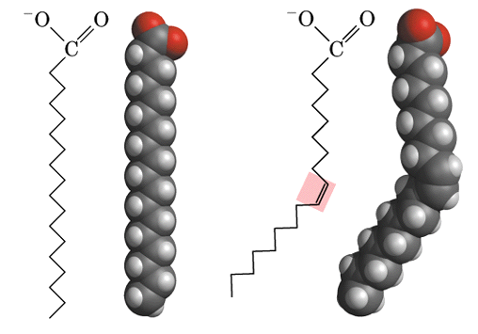
Types of Lipids
Fatty Acids are monomers of most lipids (sometimes glycerol)
Fatty Acids can be a(n):
1. (Fats) -- Saturated Fatty Acid - no double bonds- holds maximum amount of hydrogens, solid at room temperature
2. (Oils) -- Unsaturated Fatty Acid - one or more double bonds, creating a bend in the molecule, holds fewer hydrogens, liquid at room temperature

Slide 12
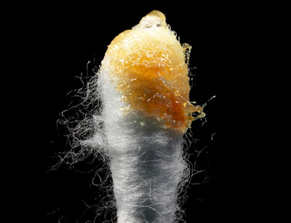
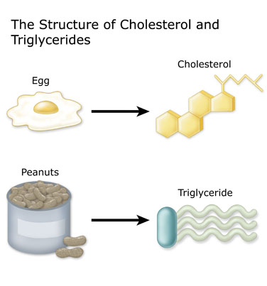
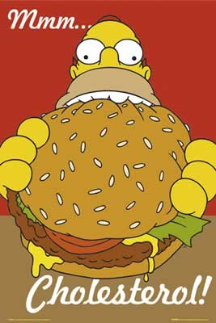
Lipids continued…
The body breaks down C-H bonds to produce energy, unsaturated fatty acids have less C-H bonds so they give less energy.
Types of Lipids:
3. Waxes - water proofing (skin, fur, feathers) protective coating on plants.
4. Steroids – Maintain and control functions throughout the body.
Ex. Cholesterol & sex hormones (testosterone and estrogen)

Slide 13
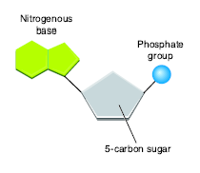
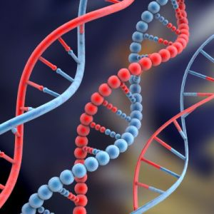
Nucleic Acid
Large polymer molecule made of C, H, O, N, and P atoms
Chains of Monomer called nucleotides
Include a phosphate group, sugar and a nitrogen base
Types of Nucleic acids:
DNA - deoxyribonucleic acid, an organisms genetic material. DNA stores information to build proteins.
RNA - Ribonucleic acid, a copy of DNA, RNA carries the code to build the proteins

Slide 14
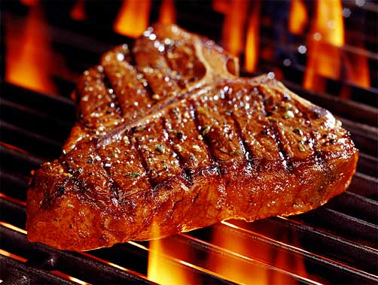
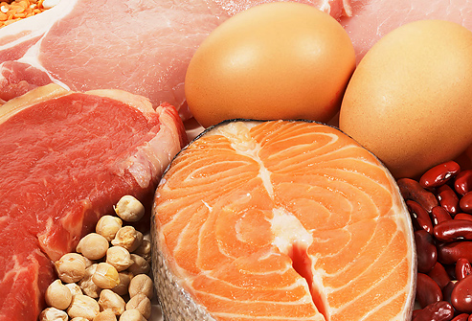
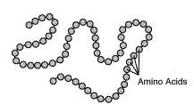
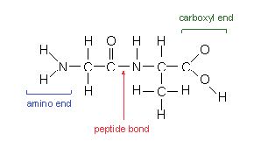
Proteins
Polymer made of C, H, O, N and sometimes S
Proteins are long chains of amino acids (monomers) linked together by a peptide bond
Examples: insulin (important for metabolism and utilization of energy from glucose), hemoglobin (blood to carry oxygen)
Dipeptide – 2 amino acids held by a peptide bond
Polypeptide – many amino acids held by a peptide bond
20 different amino acids

Slide 15
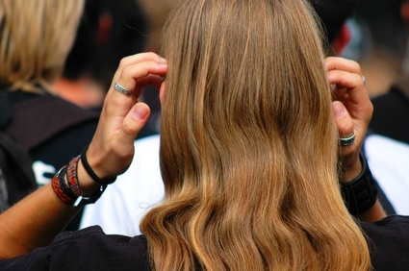
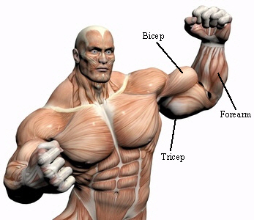
Proteins are used for:
1. Structured functions - hair and skin
2. Muscle movement
3. Chemical reactions (enzymes)
- Enzymes are proteins and help speed up a reaction
* Protein are not a good source of energy. The body will utilize proteins as a last resort.

Slide 16
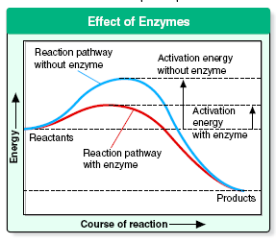
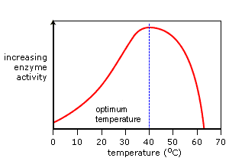
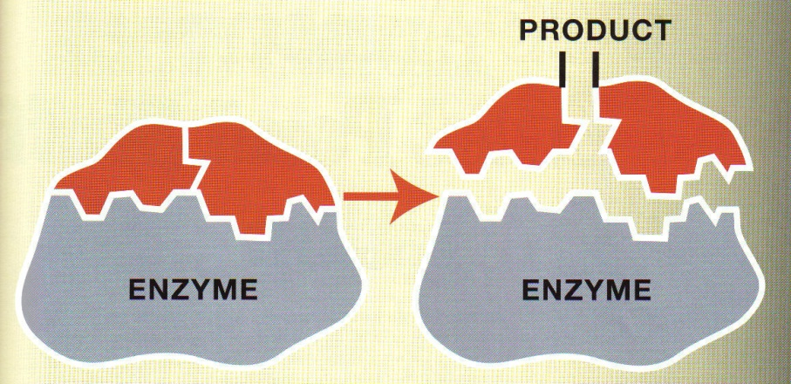
Enzymes
Enzymes are a type of protein
They speed up a chemical reaction (serve as a catalyst) by lowering the activation rate.
Almost all metabolic reactions are helped along by enzymes
Enzymes function at a specific temperature, pH, and concentration (amount of enzyme).
Ex. Pepsin enzyme in the stomach - works at a pH of 2
Substrate
Enzymes names usually end in - ase
Ex. Lipase - breakdown fats
catalase – breakdown hydrogen peroxide in tissues
amylase - breakdown starch, saliva is an amylase
Enzyme is reused
Notes:
16

