Slide 1
Classification of Matter
Matter
Stuff of which all materials are made:________________________________________________________________________________

Slide 2
Define
Atoms- Extremely small ____________________
All matter is composed of __________
Atoms ________ be broken down into smaller pieces by chemical means
The smallest distinct units in a sample of matter
Elements are made up the ________ atoms.
Elements ________ be decomposed(change) into other substances.

Slide 3
B. Pure Substances
Element
_________________________________
EX: copper wire, ____________________

Slide 4
Define
Molecule – _______________________________________________________________________________________________________________
A molecule is the smallest particle of a substance which exhibits the physical and chemical characteristics of the substance.
Diatomic molecules of elements :
H₂ ___ Cl₂ ___ F₂ ___ I₂

Slide 5
Define
Compounds is made up of: 2 or more different _______________________________________________________________________
H₂O CO₂
CaSO₄ HBR
Na₂O KOH
H₂ CO₃
Molecules

Slide 6
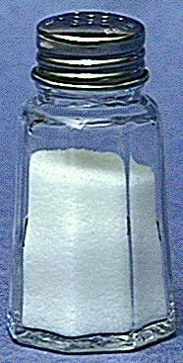
B. Pure Substances
Compound
composed of 2 or more elements in a ___________
properties differ from those of individual elements
EX: table salt (NaCl)

Slide 7
B. Pure Substances
For example…
Two different compounds, each has a definite composition.

Slide 8
Compounds
Slight differences in combinations of atoms can have large difference in properties
H₂O- water,
H₂O₂ – hydrogen peroxide
C₂ H₆O – ethanol, drinkable
C₂ H₆O₂ – ethylene glycol, poisonous

Slide 9
Compounds
Law of Definite Composition
A given compound always contains the same, fixed ratio of elements.
Law of Multiple Proportions
Elements can combine in different ratios to form different compounds.

Slide 10
Pure Substances
Same kind of ________________________
Compounds
Can be decomposed into simpler substances by __________________, always in a definite ration
Elements
__________ be decomposed into simpler substances by chemical changes

Slide 11
Mixture
Mixtures are two or more substance that are not chemically combined.
Mixtures do not ______________________
Mixtures do not have _____________________________________
Variable composition
Components retain their characteristic properties

Slide 12
Mixture
May be separated into pure substances by __________________________
Mixtures of different compositions may have widely ______________________.

Slide 13
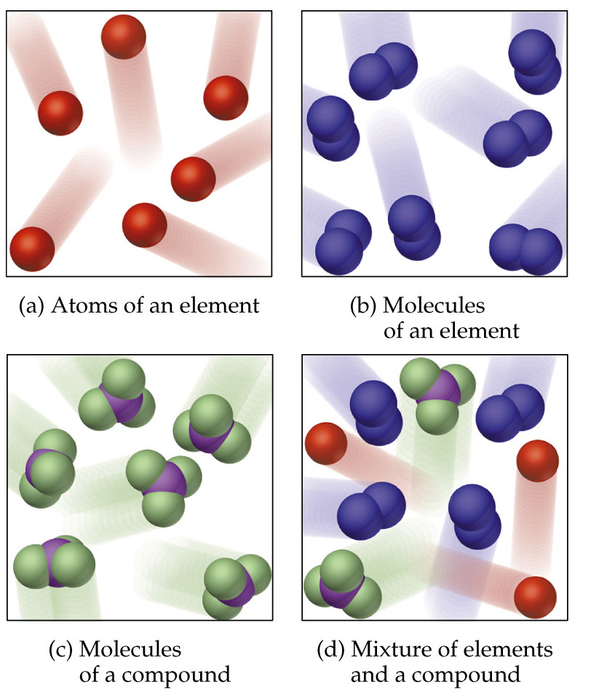
Pure Substances and Mixtures

Slide 14
Physical Separation Techniques
By ______
Filtration to separate ______ and _______
Distillation ____________________________________________________________
Chromatography ____________________________________________________________

Slide 15
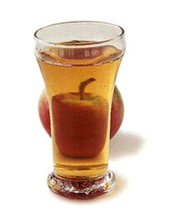
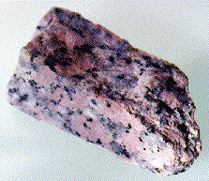
C. Mixtures
Variable combination of 2 or more pure substances.
Heterogeneous
Homogeneous

Slide 16
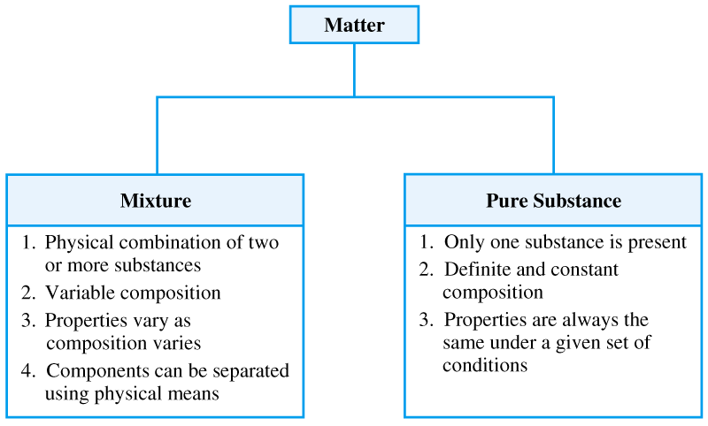

Slide 17
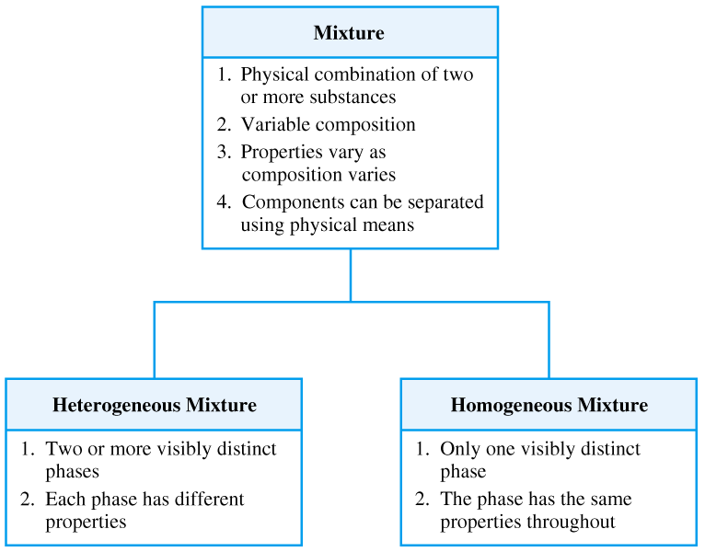

Slide 18
Types of mixtures
Homogeneous mixture
-______________________
-_____________________
-same composition in a sample
ex: _______________
Heterogeneous mixture
-_____________________ (with same or different physical states)
-each phase has different properties
ex: _____________________, _____________________

Slide 19
A. Matter Flowchart
MATTER
yes
no
Can it be physically separated?
MIXTURE
PURE SUBSTANCE
yes
Is the composition uniform?
no
yes
Can it be chemically decomposed?
no
Homogeneous Mixture
(solution)
Heterogeneous Mixture
Compound
Element
Colloids
Suspensions

Slide 20
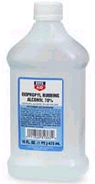
C. Mixtures
Solution
________________(same mix)
_____________________
no Tyndall effect
Tyndall Effect
particles don’t settle
EX: rubbing alcohol

Slide 21
C. Mixtures
Colloid
_____________________
medium-sized particles
Tyndall effect
_____________________
EX: milk

Slide 22
C. Mixtures
colloid
suspension
colloid
solution
suspension
Examples:
mayonnaise
muddy water
fog
saltwater
Italian salad dressing

Slide 23
A. Matter Flowchart
Examples:
graphite
pepper
sugar (sucrose)
paint
soda
element
hetero. mixture
compound
hetero. mixture
solution

Slide 24
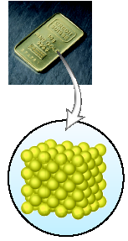
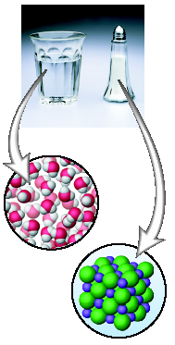
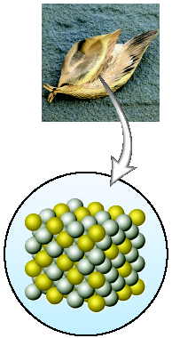
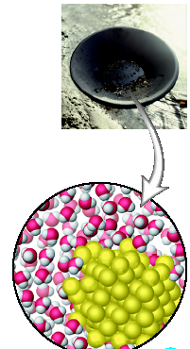
Classifying Matter

Slide 25
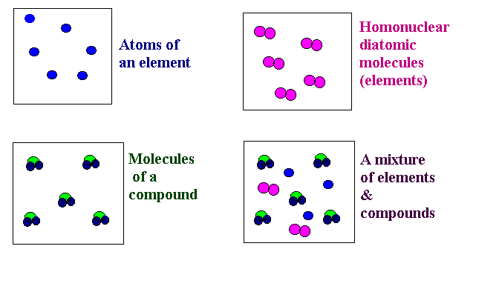
The Atomic-Molecular Theory of Matter A “microscopic” view

Slide 26
PRACTICE PROBLEMS #4
1. Classify the following as an element, compound, or mixture (heterogeneous or homogeneous).
_____ air _____ oxygen
_____ tin can _____ sugar
_____ Windex _____ crude oil
_____ suntan lotion _____ gummi bear
2. A white solid is dissolved in water. The resulting colorless, clear liquid is boiled in a beaker until dryness. White crystals remain in the beaker. The liquid can be classified as a(n) ______________.
3. Classify the following as physical or chemical changes.
_____ photosynthesis _____ baking
_____ writing with pencil _____ snowing

Slide 27
GROUP STUDY PROBLEM #4
1. Classify the following as an element, compound, or mixture (heterogeneous or homogeneous).
_____ soda _____ apple juice
_____ penny _____ table salt
_____ Bleach _____ wood
_____ diamond _____ vinegar
2. A clear blue liquid in an open beaker was left in the hood. After 1 week, the beaker contained only blue crystals. The original liquid can be classified as a(n) ______________.
3. Classify the following as physical or chemical changes.
_____ perspiration _____ sugar dissolving
_____ fermentation _____ aging

