Slide 1
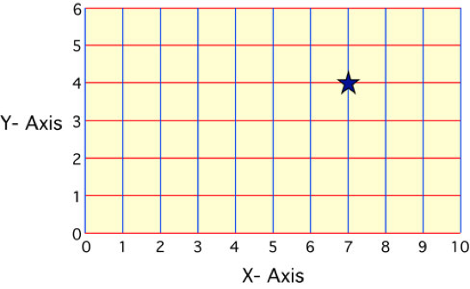
Coordinate system- a system of intersecting lines used to determine locations on the Earth’s surface

Slide 2
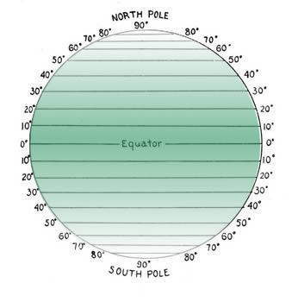
Latitude
Measure North and South from Equator
Parallel (Imaginary lines East to West)
Equator = 0⁰
Divides N and S hemispheres
North and South Poles = 90⁰ N and S

Slide 3
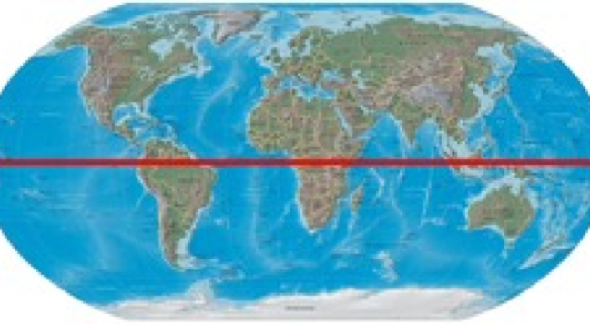
Equator

Slide 4
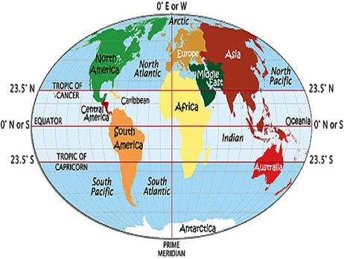
Tropics of Cancer and Capricorn
•Tropic of Cancer: 23.5°N
•Tropic of Capricorn: 23.5°S
Furthest N or S to see sun directly overhead at sometime in the year.

Slide 5
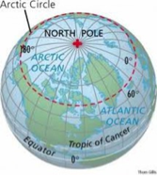
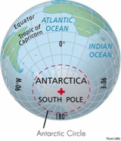
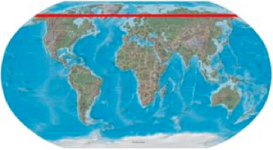
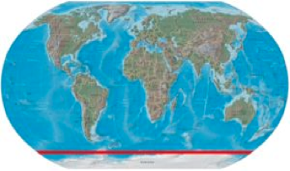
Arctic and Antarctic Circles
•66.5° N & S of equator

Slide 6
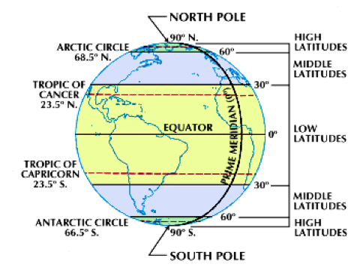

Slide 7
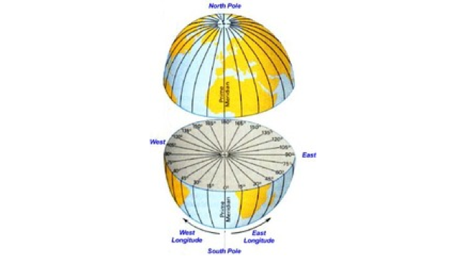
Longitude = Meridians
Imaginary lines run N to S
Measures distances in degrees E and W from Prime Meridian: Eastern and Western Hemisphere
Intersect at poles
•Prime Meridian --> 0º (Greenwich, England) reference line (home of Royal Naval Observatory)

Slide 8
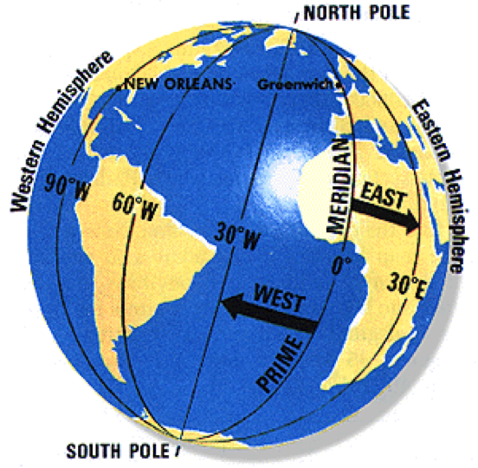

Slide 9
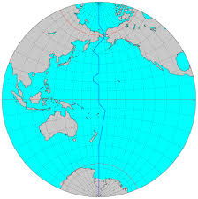
International Dateline
The International Date Line serves as the transition line for calendar days.
Go West of line = advance one day
Go East = move back one day
Highest possible Longitude = 180 (IDL)
Notes:
24 time zones each representing a different hour
Every hour the earth spins ~ 15 degrees; each time zone roughly 15 degrees

Slide 10
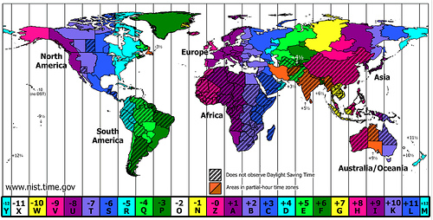

Slide 11
Types of Maps
•Projections: Transferring points and lines from globe’s surface to sheet of paper.
–Mercator projections
–Conic projections
–Gnomonic projections

Slide 12
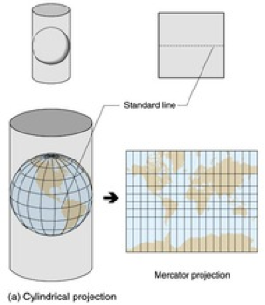
Type of Cylindrical map projection

Slide 13
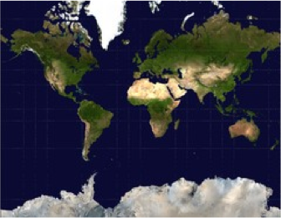
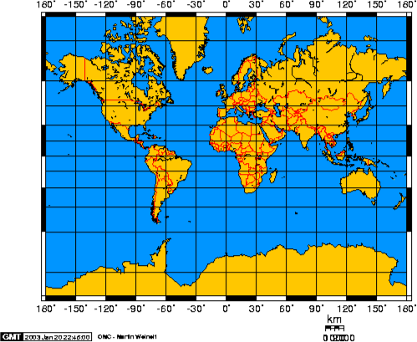
Mercator Projections
Has parallel lines of latitude and longitude
Landmasses near the poles are exaggerated
Most commonly used for navigation of ships
Notes:
Greenland appears much larger than Australia
Good for navigation since show correct shapes of landmasses and also clearly indicate direction in straight lines

Slide 14
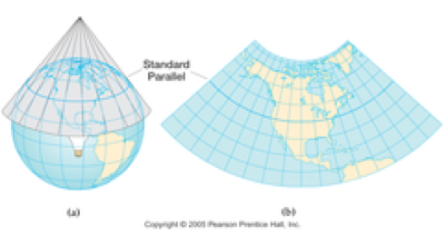
Conic Projection
Accuracy in area where cone falls alone line of latitude.
Good for making road and weather maps.
Notes:
Conic projection most accurate at the poles.
Particularly good at East-West projections
Made by putting a cone over the Earth to keep distances intact as directional qualities are lost.

Slide 15
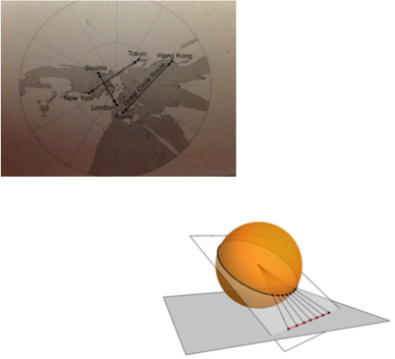
Gnomonic Projections
Projection from light source at middle of earth
Good for finding Shortest paths
Good longitude lines but latitude lines distorted
Notes:
Gnomonic = great circle

Slide 16
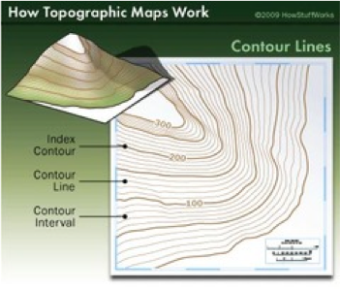
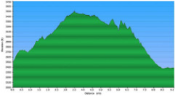
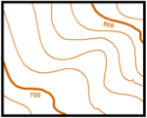
Topographic maps
Elevation: Height above sea level.
Contour interval: Difference in elevation between two side-by-side contour lines.
Contour Lines: Connect points of equal elevation.
Notes:
Draw on board Depression contour lines with hachures that indicate the direction of a depression . pg 37
Contour lines with short lines at right angles to the contour line to indicate depression like volcanic craters and mines.

Slide 17
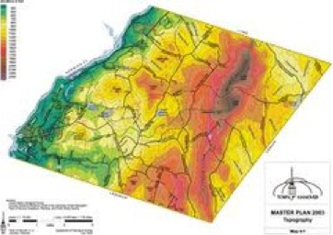
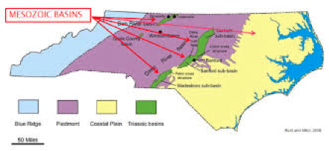
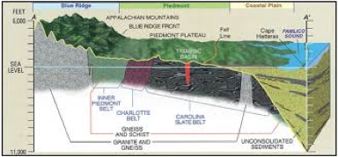
Geologic Maps
Show Interior layers:
type of rocks & soil
features such as fault lines bedrock and geologic formations
Notes:
Used to:
•Gather information about geological trends
•Color coded type of rock formation
•Note Symbols for mineral deposits present and structural features

Slide 18
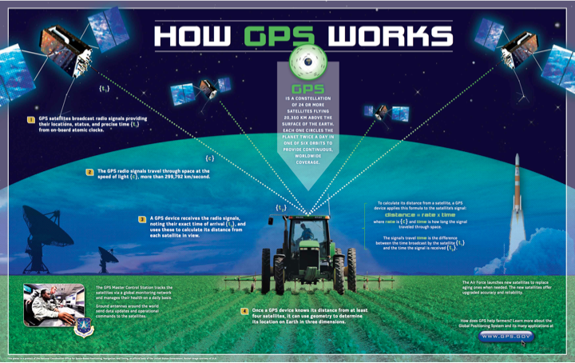
Global Positioning System
Notes:
http://oceanservice.noaa.gov/education/lessons/where_you_are.html
There are ~24 satellites orbiting Earth so that signals from at least 3 or 4 satellites can be picked up at any given moment by a GPS receiver to calculate your approximate lat and long. Usually with 10 meters.

