Slide 1
Tectonic Plates

Slide 2
The Formation of a Theory
In 1915, a German scientist named Alfred Wegner came up with the theory of continental drift.
His hypothesis was that all the continents were once connected to form a supercontinent called Pangaea.
This theory suggested that the continents gradually separated from one another over millions of years.

Slide 3
Moving Proof
Proof that supports the theory of moving continents include:
Similar fossils on different continents
Glacier groove patterns on different
continents
The continents appeared to fit together

Slide 4
Fact or Fake?
At the times Wegner’s theory was not accepted by fellow scientists.
They recognized Wegner’s proof as being the effect of polar wandering, not moving continents.
Later in the 1940’s and ‘50’s, Wegner’s theory and proof lead to the theory of sea floor spreading and convection currents; all of which ended up leading to the tectonic plate theory.

Slide 5
Theory of Continental Drift
The Theory of Continental Drift originally stated that all continents were atop a liquid core which allowed them to move.
Convection currents in the Earth’s mantle were thought to be the cause of the movement.
Since Earth’s surface isn’t very dense, it was easier for these big masses of land to start moving away from each other.

Slide 6
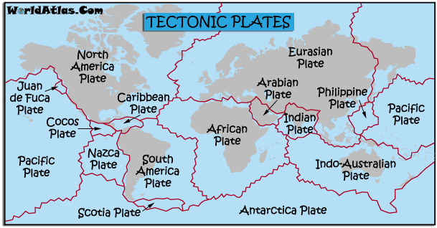
Tectonic Plate Theory
According to the plate-tectonics theory, Earth's surface is broken into a number of shifting plates.
These plates move in relation to one another above a hotter, deeper, more mobile zone at average rates.

Slide 7
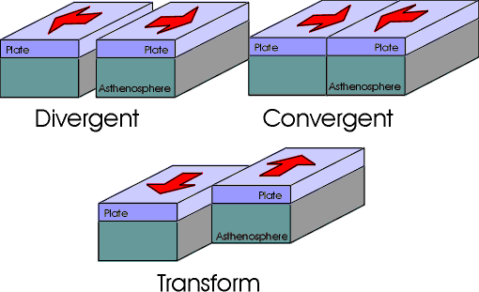
Different Boundaries, Different Actions
There are three types of boundaries that occur at tectonic plate fault lines.
These boundaries include divergent, convergent, and transform.
Each of these boundaries move differently as well as cause diverse events.

Slide 8
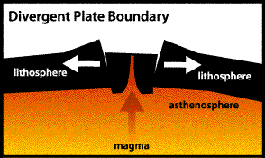
Divergent Boundary
Places where plates are coming apart are called divergent boundaries.
When Earth's lithosphere is pulled apart, it usually breaks along parallel faults that tilt away from each other.
As the plates separate along the boundary, the block between the faults cracks and drops down into the asthenosphere. The sinking of the block forms a central valley called a rift.
Magma seeps upward to fill the cracks. In this way, new crust is formed along the boundary.
Earthquakes occur along the faults, and volcanoes form where the magma reaches the surface.

Slide 9
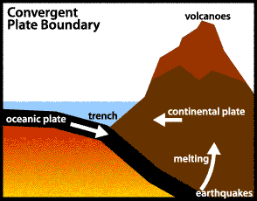
Convergent Boundary
Places where plates collide are called convergent boundaries.
Collisions are very slow and last millions of years.
There are three kinds of convergent boundaries: continental-oceanic, oceanic-oceanic, and continental-continental.

Slide 10
Convergent Boundary
Continental-oceanic boundaries are when a land plate and an ocean plate converge. These boundaries cause trenches and earthquakes to form.
In continental-oceanic boundaries, the oceanic plate subducts under the continental plate, causing trenches to form.
Continental-continental boundaries are when two lands plates converge. These boundaries cause mountains to form.
Oceanic-oceanic boundaries are when two oceanic plates converge. These boundaries cause trenches as well as undersea volcanoes.

Slide 11
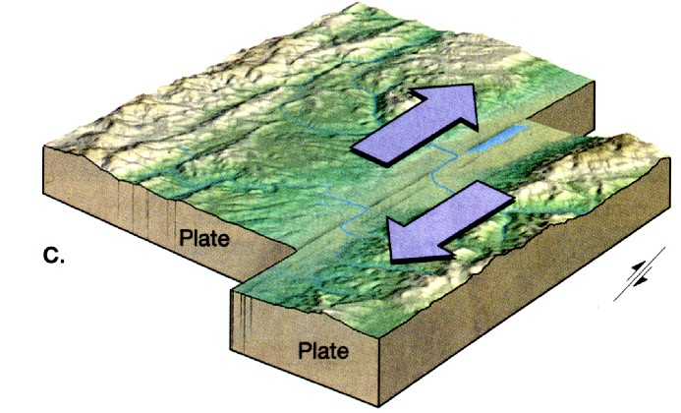
Transform Boundary
Places where plates slide past each other are called transform boundaries.
The plates on either side of a transform boundary are merely sliding past each other.
This boundary causes earthquakes and valleys to form.

Slide 12
Citations
http://www.stockton.edu/~hozikm/geol/Courses/The%20Earth/Content%20Web%20Pages/Bugielski/webpage.htm
http://www.infoplease.com/ipa/A0001765.html
http://www.cotf.edu/ete/modules/msese/earthsysflr/plates3.html
http://www.platetectonics.com/book/page_5.asp

